Slide 1


PRESENTATION SKILLS
PREPARED BY:-
ASHISH SINGH(13)
DEVENDRA MEHTA(17)
SHASHWAT BHATTACHARYA(55)
B.tech (E&CE) IV SEMESTER
AMITY UNIVERSITY

Slide 2

WHAT IS A PRESENTATION ?
KNOW
THINK
ANALYSE
PARTICIPATE

Slide 3
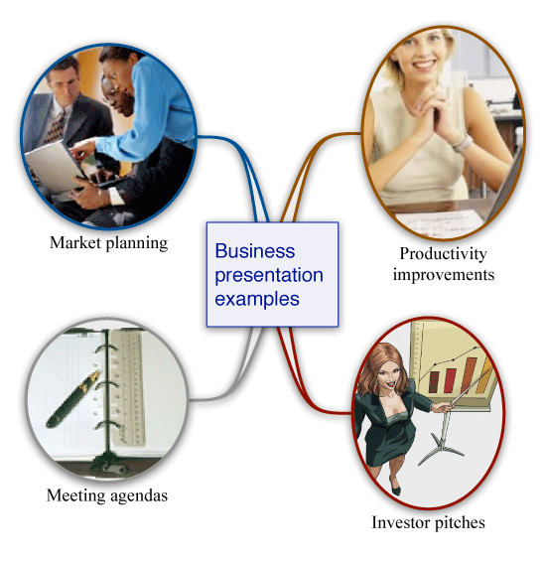


IMPORTANCE OF PRESENTATION IN TODAYS ERA
BUSINESS WORLD
MEDICAL &
TECHNICAL WORLD
EDUCATION

Slide 4

HERE IS KEY FOR YOUR PRESENTATION OR SUCCESS
OBJECTIVE OF PRESENTATION
FORMULATE YOUR OBJECTIVE
IDENTIFY THE AUDIENCE
STRUCTURE

Slide 5
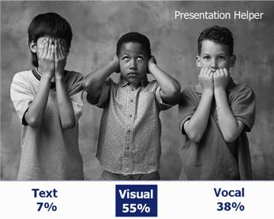
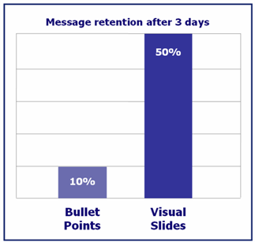

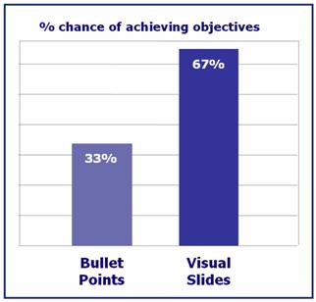
MAKE THEM TO SEE AND HELP TO REMEMBER

Slide 6


PRESENTOR
ARE YOU AFRAID OF BEING ON THIS SIDE IN ANY PESENTATION OR PUBLIC SPEAKING ?

Slide 7

IF YOUR ANSWER IS YES...
PRACTICE
PRACTICE
&
PRACTICE

Slide 8



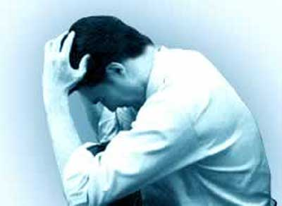
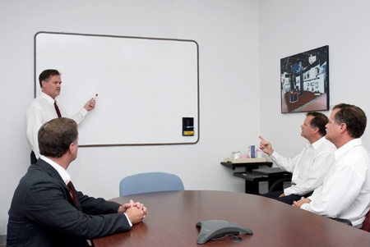
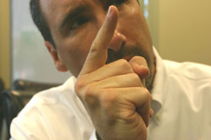
A SPEAKER SHOULD WORK ON :
TIME LIMIT
VOICE
BODY
NERVES
LISTENING
QUESTIONS

Slide 9

DO’S AND DONT’S
DRESS FORMALLY
BE HUMOROUS
ENCOURAGE PARTICIPATION
USE SILENCE
DO NOT READ
DO NOT USE SPECIAL EFFECTS
DO NOT PUT TEXT ON SLIDES
DO NOT SPEAK IN MONOTONE

Slide 10

LETS SEE WHAT IS THIS
THIS RULE IS INTRODUCED BY
FAMOUS VENTURE CAPITALIST GUY KAWASAKI OF CHINA
10- SLIDES
20- MINUTES
30- SIZE OF FONT USED

Slide 11

CONCLUSION

Slide 12

REFRENCES
GOOGLE SEARCH
YAHOO SEARCH
ENCARTA
Editin .com

